Slide 1

Product Management
Certification Program
Industry Project – I Submitted By:
Chaitra Mahadevappa
Jyoti Kumari
Sameet Suryawanshi
Achal Kagwad
Notes:
© Copyright UpGrad Education Pvt. Ltd. All rights reserved

Slide 2
Submission Guidelines
After completing all the parts of the project, you will have to submit your responses in the following manner.
Submit the following parts of the project in this “Presentation’’ file
Part 1 - Understanding the market
Part 2 - User research
Part 5 - MVP Creation
Part 6 - Sketching
Part 7 - Wireframing & Prototyping
Submit the following part of the project in the template document provided on the platform.
Part 3 - Business Model Canvas
Part 4 - Product Artifacts
User Persona
User Journey Map
Note: Finally you have to add this Presentation & other submission documents in a ZIP folder and upload it in the submission section on the platform. More details in slides to follow
Notes:
© Copyright UpGrad Education Pvt. Ltd. All rights reserved

Slide 3
Part 1: Understanding the Market
Notes:
© Copyright UpGrad Education Pvt. Ltd. All rights reserved

Slide 4
Target Market Identification
TAM(Total Available Market): All people in India who have access to Internet and want to order food online. Estimation: India’s population is 138Crores, out of which we have statistic that 54% have access to internet in 2022. Thus TAM is around 75Crore.
SAM(Serviceable Addressable Market ): To obtain this we filter by geography. We state that Tier 1 City Population is our SAM. We analysed the statistic that 3% of total internet users in India live in Tier 1 Cities. Thus SAM is 2.25Crore.
SOM(Serviceable Obtainable Market): Here we filter by age. We are targeting age group of 18 to 40. Assuming 30% of SAM fall in this age bracket we have SOM as around 68Lakhs.
Notes:
© Copyright UpGrad Education Pvt. Ltd. All rights reserved

Slide 5
Porter's Five Forces Analysis
Threat of New Entry: Weak Force
Entering this market requires long term(in years) planning, high costs to create multisided platform, onboarding restaurants and end users
It takes years to have regular customer base
Technology and Infrastructure costs keep scaling with new users
Skilled Tech Talent demands high CTC
The four phases to hook a customer: Trigger, Action, Variable Reward and Customers Investment into app takes time and planning.
Threat of Substitutes: Strong Force
Currently Users have many substitutes to solve their food problem, Local Restaurants provide low cost of switching.
Local Gated Apartment Home Chefs are operating their own small enclosed home chef models. Need to break this network and onboard both multisides on our platform.
Notes:
© Copyright UpGrad Education Pvt. Ltd. All rights reserved

Slide 6
Porter's Five Forces Analysis
Bargaining Power of Buyers: Strong Force
Cost of switching is low, Highly price sensitive market with existing players of Swiggy and Zomato.
Availability of substitutes: Home Cooks, Home Chefs, Local Restaurants.
Bargaining Power of Suppliers: Moderate Force
Until user is hooked to our platform we have low supplier bargaining power.
Local Gated Apartment Home Chefs are operating their own small enclosed home chef models. Need to break this network and onboard both multisides on our platform.
Need of Volume of Orders to Suppliers- Cloud Kitchens using our services, but some fine dining restaurants not very much dependent on our platform. Thus Moderate Force.
Notes:
© Copyright UpGrad Education Pvt. Ltd. All rights reserved

Slide 7
Porter's Five Forces Analysis
Competitive Rivalry: Strong Force
Few Competitors but they are already established and threat is strong
Diversity of competitors capturing niche segments. Eg apart of Swiggy and Zomato we have Dominos Pizza, Instamart and other mushrooming niche segment apps
Swiggy Zomato become giants by acquiring other food tech apps, UberEATS, food panda(More details in other analysis segments)
Notes:
© Copyright UpGrad Education Pvt. Ltd. All rights reserved

Slide 8
Porter's Five Forces Template
Threat of Entry
“Weak Force”
Bargaining Power of Buyers
"High”
Competitive Rivalry
"Strong Force”
Bargaining Power of Suppliers
"Moderate”
Threat of Substitutes
“Strong Force”
Notes:
© Copyright UpGrad Education Pvt. Ltd. All rights reserved

Slide 9
Competitor Analysis
Major Players: Swiggy, Zomato, Eat Sure, Freshmenu, Hunger Box, Box8
Two Direct Competitors: Swiggy and Zomato
Company Background of DC1 and DC2 We next, will be doing a comprehensive analysis between Swiggy and Zomato
Notes:
© Copyright UpGrad Education Pvt. Ltd. All rights reserved

Slide 10
Competitor Analysis- Company BackGrounds
CRITERIA | SWIGGY-DC1 | ZOMATO-DC2
Goals | Integrate with Restaurant Partners and provide seamless food delivery experience | Change the way Customer consumes food
Mission | Change the way India Eats | Better Food For More People
Strategy | Swiggy plans to build unified delivery platform diversifying its products across host of categories food, groceries etc. However Food Remains its highest revenue generator | Zomato has gone public. It has different segments apart from food: business consulting, Cloud Kitchen penetration. It also introduced Zomato Gold Membership
#Employees | Around 11,000 | 5000 employees
Funding | Total of 3.6B in 15 rounds till 2022 | Total of 2.5B in 21 rounds till 2022
Revenue | FY2022-4687 Crores FY2021-2118 Crores FY2020-2742 Crores FY2019-1397 Crores FY2018-485 Crores | FY2022-2300 Crores FY2021-2547 Crores FY2020-3467 Crores
Notes:
© Copyright UpGrad Education Pvt. Ltd. All rights reserved

Slide 11
Competitor Analysis- Company BackGrounds
CRITERIA | SWIGGY | ZOMATO
Founder’s Profile | SriHarsha Majety- CEO, Rahul Jaimini, Nandan Reddy | Deepinder Goyal-CEO, Pankaj Chaddah
Acquisitions | 4 Acquisitions Kint.io-2019 Supr Daily -2018 Scootsy- 2018 48East- 2017 | 14 Acquisitions. Major Ones Below Menu Mania-2014 Maple Graph-2015 Sparse Labs-2016 Uber Eats-
Target Market | Age 18 to 35 These are college students, working professionals, or entrepreneurs who have a good lifestyle and live in upscale neighborhoods. | Both Apps almost similar target market of youth between 18 to 35 who have access to internet and smart phone.
Notes:
© Copyright UpGrad Education Pvt. Ltd. All rights reserved

Slide 12
Competitor Analysis- Business Models
CRITERIA | SWIGGY | ZOMATO
Value Added Services | Food Delivery at Doorstep, Live Order Tracking, Swigger Stores-Groceries, Flowers, Medicines, Swiggy Genie- Package Delivery Service, Swiggy Super- Membership Program | Food Delivery at Doorstep, Live Order Tracking, Zomato Gold-Membership Program, Go Out- Dine in experience, Explore- Feature in App
Geographical Reach | Currently 500 cities, Target to expand to 600 more cities | 24 Countries and 10,000 plus cities
Revenue Model | FY2022-4687 Crores FY2021-2118 Crores FY2020-2742 Crores FY2019-1397 Crores FY2018-485 Crores | FY2022-2300 Crores FY2021-2547 Crores FY2020-3467 Crores
Daily Order | Daily Orders: ~1.7 Million Order/Day | Daily Orders: ~1.5 Million Orders/Day
Avg Order Value | Avg Order Value: ~ Rs400/- | Avg Order Value: ~ Rs400/-
Notes:
© Copyright UpGrad Education Pvt. Ltd. All rights reserved

Slide 13
Competitor Analysis- Business Models
CRITERIA | SWIGGY | ZOMATO
Shift in Business Model | Swiggy Started as a 3 way market place between restaurants, Food Consumers and Delivery agents. Restaurants pay % commission to Swiggy. Consumers pay extra amount for delivery rather than travel, In recent times Swiggy has created other channels to increase their revenue such as Swiggy Genie- Package Delivery Services, Swiggy Instamart- Groceries, Flowers, Medicines etc Thus Swiggy is scaling both horizontally and vertically in different geographies. | Zomato began as an online restaurant directory with ratings, viewership etc. it had entered segments such as live events, restaurant reservations etc. However now Zomato with its online food delivery value proposition is more focusing on scaling vertically in various countries and cities. It has also gone public with IPO.
Notes:
© Copyright UpGrad Education Pvt. Ltd. All rights reserved

Slide 14
Competitor Analysis- Strengths and Weaknesses
CRITERIA | SWIGGY | ZOMATO
Strengths | Fast Delivery – Target withins 30 Mins-Tech Driven Investment in Good App Development Training of employees. Seamless Process Broad range of extensive menu. Recommendation systems in app. | First Mover Advantage Fast Expansion: Already in 24 Countries Intuitive and Seamless App Design: Helps you find restaurants in nearby and new areas. Number of Users: Site receives approx. 90m visitors/month, thus more reviews and stronger marketplace Brand Equity Presence Acquisitions in Tech to have strong HR and Infrastructure
Weaknesses | Limited Zones for order Placing Low Brand Recognition: Swiggy to invest in positive brand recognition Exclusive Delivery Fees charged to customers. Swiggy can experiment with this revenue model. | App security Concerns: An event of customer data being hacked tarnished its image. The speed of expansion given the funding could be much better Competition from local food discovery apps
Notes:
© Copyright UpGrad Education Pvt. Ltd. All rights reserved

Slide 15
Competitor Analysis- Strengths and Weaknesses
CRITERIA | SWIGGY | ZOMATO
What Works Well | Fast Delivery, Variety of cuisines, Good Food Discovery platform Swiggy One Membership designed to cut delivery costs to customer. | Large Customer Base in 24 countries, Economies of Scale advantage, Good “Go Out” Feature. For Dining Out. Discovery of fine dining restaurants, Good Analytics work to maximize customer revenue and loyalty. Ongoing Offers and coupons to drive loyalty
Pain points | Limited Zones for order Placing Low Brand Recognition: Swiggy to invest in positive brand recognition Exclusive Delivery Fees charged to customers. Swiggy can experiment with this revenue model. | Not keeping price model predictable within a standard deviation range. Over use of Supplier Power can diminish brand value and customer loyalty.
Notes:
© Copyright UpGrad Education Pvt. Ltd. All rights reserved

Slide 16
Competitor Analysis- Product Reviews
CRITERIA | SWIGGY | ZOMATO
App Downloads | 100M on Android play store and 80M on iOS store | 100M on Android Play Store and 70M on iOS store
App Ratings | 4.5 stars on play store, and 4.4 on iOS store | 4 stars of play store and 4.6 on iOS store
UX of App | Design Of App: Intuitive, Clear Root Icons at the bottom indicating their functionality. Does not allow to build multiple carts from different restaurants. Has various features such as user personalization with recommendations. The app also show cases its other features such as swiggy genie for delivery package. | Zomato also has root icons at he bottom indicating their functionality. The Home Page has major categories such as “Order Again”, “In the Spotlight”, “Recommended For you”, categorization by cuisine and Promoted restaurants. This increases the chances of user ending up buying up food. It Dining button below which takes the dine out user journey, The Money button has “One Click Check Out” which saves time. However the home page scrolls down indefinitely where there can be definite end. Overall the app UX is neat.
Notes:
© Copyright UpGrad Education Pvt. Ltd. All rights reserved

Slide 17
Competitor Analysis- Product Reviews
CRITERIA | SWIGGY | ZOMATO
User Feedback of Apps and Service | Analyzing comments on playstore and app store, we see users are in general satisfied with the app and services. Certain payment issues were seen. High Surge prices for delivery and packaging were seen to downgrade customer mood and sentiment. | While User experience of app has much complains, the service does have, lack of prompt customer service were reported. Friends posting reviews is a plus. Good sense of loyalty towards Zomato Conducting “Zomaland” Food Music and Fun Fest Carnival in select cities has boosted brand image and loyalty.
Notes:
© Copyright UpGrad Education Pvt. Ltd. All rights reserved

Slide 18
Competitor Analysis- Future Initiatives of DC1,DC2
CRITERIA | SWIGGY | ZOMATO
Predict Future Initiatives with Reasoning | Swiggy boasts a huge fleet of delivery agents. It can use this to its advantage in scaling horizontally with groceries, Package pick ups. Penetrate into tier 2 and tier 3 cities with much granularity and make customers hooked to them. Swiggy has already started “Instamart” on these lines | Zomato has already established presence in 24 countries and 10,000 cities. Its next move could be build monopoly in becoming one stop solution to discover new food. Low Capital cost, Data as a raw material and economies of scale are factors that can drive Zomato growth to be profitable and monopoly.
 | Data as a raw material can be exploited for various horizontals of swiggy. | Zomato may look in establishing cloud kitchen network partners and with its in house data and resource may derive useful insights in optimizing costs and increasing revenue by building Inhouse kitchens which sell top seller dishes in various geographies Zomato can later use tech driven delivery mechanisms such as drone delivery to streamline delivery process.
Notes:
© Copyright UpGrad Education Pvt. Ltd. All rights reserved

Slide 19
Part 2: User Research
Notes:
© Copyright UpGrad Education Pvt. Ltd. All rights reserved

Slide 20
Objectives and Hypotheses
Objectives
To determine the demand for a new food delivery app/platform.
To gauge user’s interest in food scheduling feature
To understand user’s pain points for the quality of food delivered.
To understand the affordability of the food order.
To understand the time taken to order each meal including search, add, apply offers etc,
Notes:
© Copyright UpGrad Education Pvt. Ltd. All rights reserved

Slide 21
Hypothesis
Hypothesis 1: Bachelors are willing to order home cooked food.
Hypothesis 2: People will order more frequently if there are more offers/discounts.
Hypothesis 3: People would try new food delivery apps if more reasonable prices.
Hypothesis 4: Working professionals would order food more frequently.
Hypothesis 5: Working professional would love to have a food order scheduling feature.
Hypothesis 6: Working professional would love to have a food order reminder feature.
Hypothesis 7: People staying with family will order food once a week.
Hypothesis 8 : People prefer subscription plans which cuts down delivery charges.
Hypothesis 9 : People would like to have a plan subscription plan for their food they order regularly.
Hypothesis 10: Time taken for from searching to placing order during busy schedule is very challenging.
Hypothesis 11: Users want to have the mix and match of the choice of their food items.

Slide 22
Surveys: Conducted for 32 Users
The Survey questionnaire Link :
https://docs.google.com/forms/d/1EU-MIWPQQYOHK1u8iGDKJ3Vf0_DBYyLGUgt2A4Ggbo4/edit
The Survey response Link :
https://docs.google.com/forms/d/1EU-MIWPQQYOHK1u8iGDKJ3Vf0_DBYyLGUgt2A4Ggbo4/edit#responses
The survey Excel version Link:
https://docs.google.com/spreadsheets/d/1zdbBiRc4SRwmclEHuQSF_Rc-6J_wWJOlbs9rXTHz-bI/edit?resourcekey#gid=1979482262
Notes:
© Copyright UpGrad Education Pvt. Ltd. All rights reserved

Slide 23
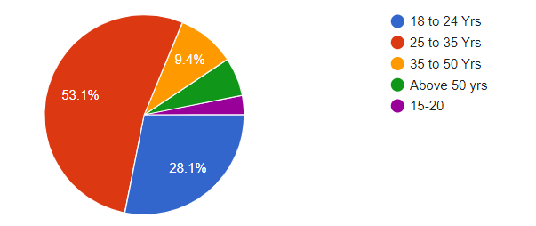
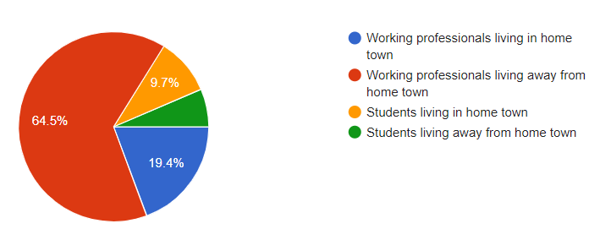
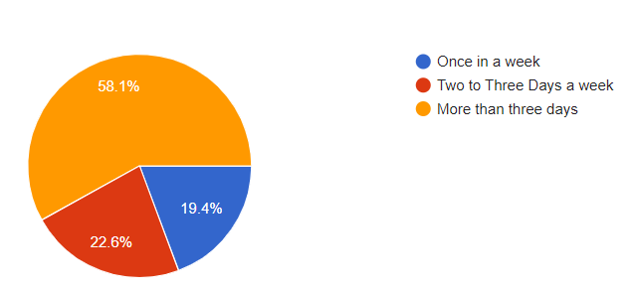
Survey Analysis
64.5% of Working professionals who are away from hometown and 19 % of who are living in their hometown are ordering the food frequently (more than three days a week) and this proves hypothesis 4.

Slide 24
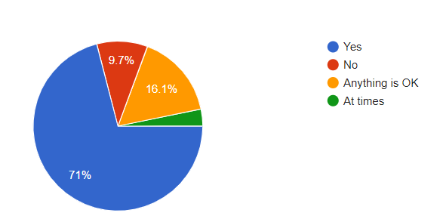
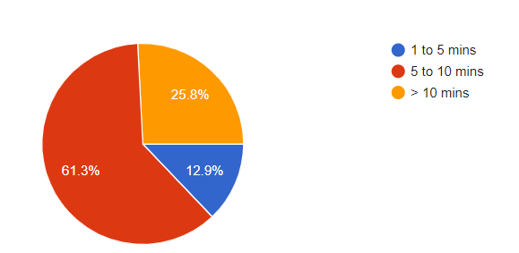
Survey Analysis
61 % & 15 % of user takes more than five mins to order each meal per days and hence 71% user would like to pre-order the food instead of ordering 3 times every day proves hypothesis 5 and 10.

Slide 25
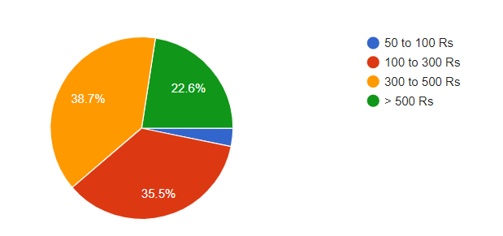
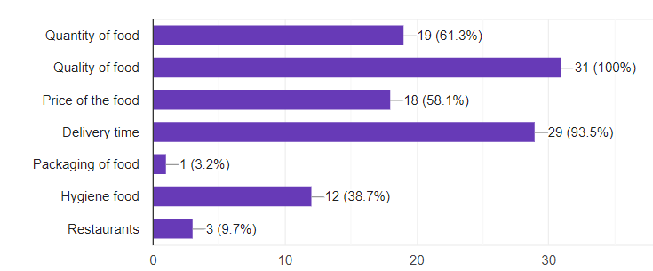
Survey Analysis
38% and 35% are paying more than 300rs per day for food & also 58 % are concerned about the price of the food, which calls for good subscription plans that proves Hypothesis 8 and 9.

Slide 26
Interviews Questions
Name
What is your age bracket
Native Place
Profession/Area of work
How do you Order food online
How frequently do you order food.
On what occasions do you order food.
What is the primary reason for ordering food online
What is the choice of food you would want.
Would you like to have subscription plan for your regular choice of food.
Which food app subscription plans do you have
What motivates you to take subscription plan
What is your opinion of the restaurant food.
Notes:
© Copyright UpGrad Education Pvt. Ltd. All rights reserved

Slide 27
Interview Questions.
14. Do you have diet restrictions
15. How much would you rate the exp. of ordering food.
16. What impacts does discounts and offers have on your food ordering habits
17. How much time you would be ok to wait for food delivery
18. How much time you normally spend to place an order.
19. How much time do you want it should take to order.
20. What are some of the improvements that you look forward to.
21. Would you like a feature which allows you to schedule your food order
22. Primary concern when ordering food.
23. Common experience with food quality
24. Overall experience of food orders placed
25. Common experience with the delivery persons
26. What are the factors which influence your choice of restaurant or place.
27. What technology they use.
28. Current location.
<Collected response should be submitted in word document format with other submission files in a zip folder>

Slide 28





Interview Insights
Maximum target audience in Tier 1 Cities
Use mobile apps
Order food 6-7 times a week
User Pain points:
Hectic to order the food every time during tight work schedule
Order tracking
Delivery time
Food quality
Coordination
Users would like to have a feature that allows them to pre book meals and set reminders.

Slide 29
Part 3: Business Model Canvas
Notes:
© Copyright UpGrad Education Pvt. Ltd. All rights reserved

Slide 30
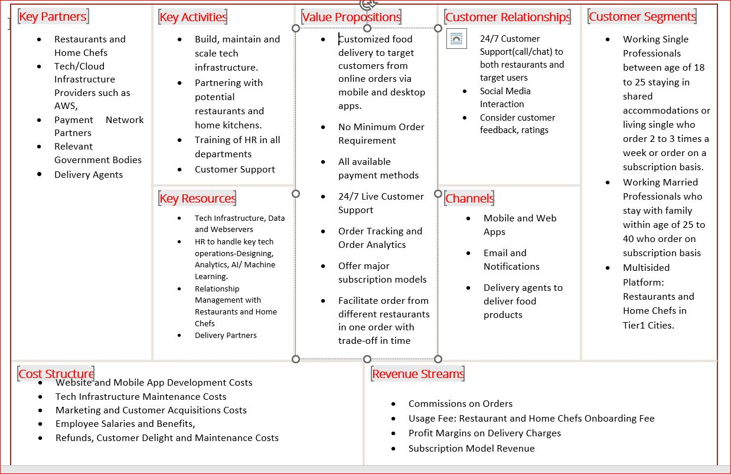
Business Model Analysis
Notes:
© Copyright UpGrad Education Pvt. Ltd. All rights reserved

Slide 31
Part 4: Product Artefacts
Notes:
© Copyright UpGrad Education Pvt. Ltd. All rights reserved

Slide 32
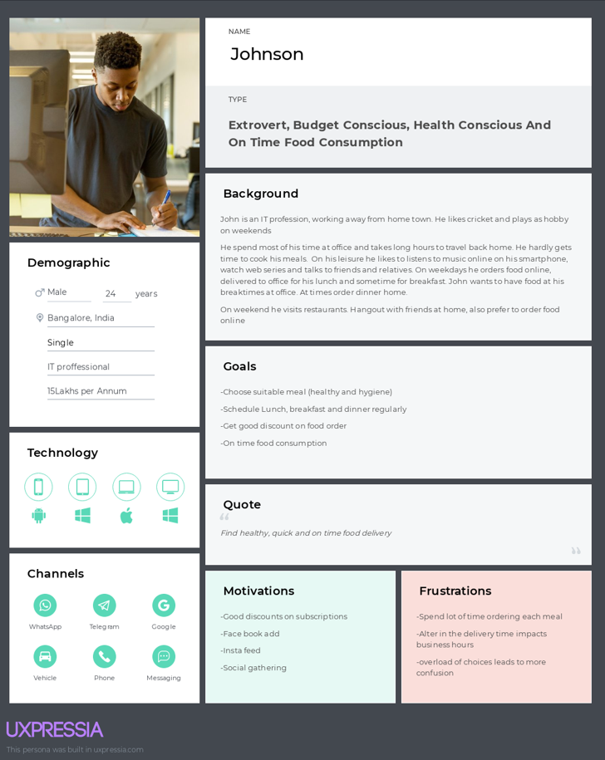
User Persona
Notes:
© Copyright UpGrad Education Pvt. Ltd. All rights reserved

Slide 33
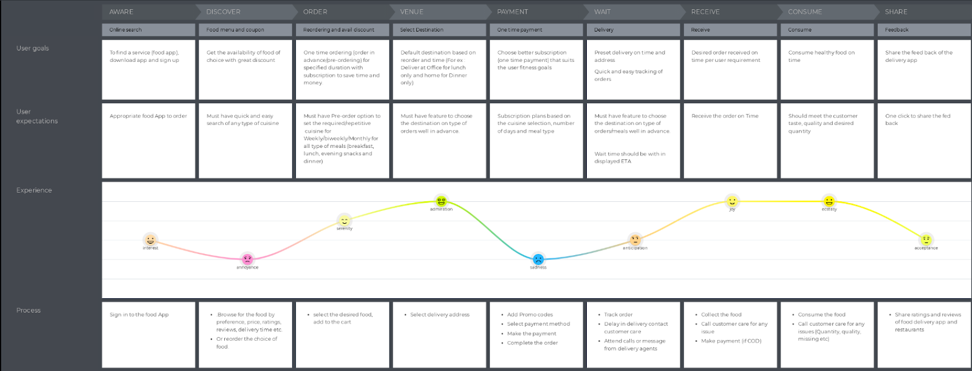
User Journey Map 1
Notes:
© Copyright UpGrad Education Pvt. Ltd. All rights reserved

Slide 34
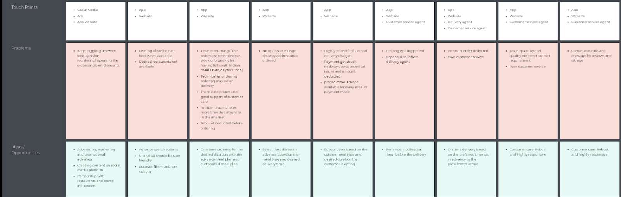
User Journey Map 2
Notes:
© Copyright UpGrad Education Pvt. Ltd. All rights reserved

Slide 35
Part 5: Minimum Viable Product Creation
Notes:
© Copyright UpGrad Education Pvt. Ltd. All rights reserved

Slide 36
Features/Functionalities
<List all the appropriate features/functionalities for the product.>
Home/Landing/Start Page
Login Page
Sign Up Page
Profile Page
Search Page
Order History Page
Order Rate page
Schedule pre order page
Subscription plan page
Add to cart page
View cart page
Final cart view before checkout
Payment page
Offers and discounts page
Notes:
© Copyright UpGrad Education Pvt. Ltd. All rights reserved

Slide 37
MVP – list of features/functionalities 2.
15. Order success page
16. Order tracking page
17. Rate your order page.

Slide 38
Must Have Features
Feature | Reason behind choosing this as a ‘Must Have Feature’
Scheduling the Pre Orders/recurring orders | This is a must have feature which we are using as our value proposition for our application, where working professionals can schedule their meals before hand for a period selected by them.
Change the delivery time, location, menu,- restaurant for their pre booked meals. | This is a super feature, which enables the user with giving the flexibility of changing their food choices and time as per their choice.
Checkout and Tracking of Order | Gives User a sense of accomplishment after ordering and tracking order feature gives real time updates which makes user complacent.
Notes:
© Copyright UpGrad Education Pvt. Ltd. All rights reserved

Slide 39
Nice to Have Features
Reminders for foods
Payment done once either before or after the subscription period.
Offers and discounts.
Notes:
© Copyright UpGrad Education Pvt. Ltd. All rights reserved

Slide 40
Part 6: Sketching
Notes:
© Copyright UpGrad Education Pvt. Ltd. All rights reserved

Slide 41
Features
Page name | It’s Features/Functionalities
App Home/Start page | It will be page users will be shown when they install open the app before login/register, it will have the brand logo, the search option, profile icon, which when clicked they will be routed to the login/Sign up page.
Login Page | This page will be shown to the users when they want to login to the app, it will the brand logo, textbox to enter the phone number, the login button and links to login from other applications like google, fb etc. they cqan login with already in use phone number
SIGN-UP page | For users who are not registered, they will be routed to this page and asked for phone, name and email and click on the Sign-Up button to register/Sign Up.
Profile Page | Has all the details like Name, phone # and email. From here user can navigate to his account details, address, payments and refunds, Offers and discounts, order history, Scheduled order details pg., there is also option for help and logout.
Search Page | Here the user can search for the food items or restaurants, the search results will be shown as the search text is typed, user can select any from the list shown.
Notes:
© Copyright UpGrad Education Pvt. Ltd. All rights reserved

Slide 42
Features
Page name | It’s Features/Functionalities
Add To Cart Page | From the list of list of food items/restaurants displayed, users can click on ‘Add’ button to add the item in the cart, also can click on the restaurant and grocery store tabs for related searches, bottom there is an option to view the full menu and checkout option.
View Cart Page | This page will be shown to the users when they have added the items they want and then go to the next page to see the order amount, offers , time etc. also can proceed with payment from button on this page.
Schedule Order Page | This is the value proposition of our app that we are going to provide to the users, for users who are having a very busy schedule and often packed with back-to-back meeting, ordering selecting items, then placing it is challenging and therefore we have this super feature of scheduling their meals ahead and setting a recurring meals option with reminders for them, users can select the date ranges can be done for an entire week at once, can select the items and the restaurants also mix and match as per their like.
Profile Page | Has all the details like Name, phone # and email. From here user can navigate to his account details, address, payments and refunds, Offers and discounts, order history, Scheduled order details pg., there is also option for help and logout.
Payment's page | Here the user can make the payment for their food, get a summary view of their order and the delivery time, all the list of preferred mode of payment and offers and Credit/Debit/UPI is listed.

Slide 43
Features
Page name | It’s Features/Functionalities
Favorites/Recent/Offered items page | In this page there is a search box for food items, restaurants, there are items displayed which are recently ordered, favorites and on offer food items displayed, from the list of food items/restaurants displayed, users can click on the items displayed and click on ‘Add’ button to add the item in the cart, also can click on the restaurant and grocery store tabs for related searches, bottom there is an option to view the full menu and checkout option.
Delivery tracking page | This page will be shown to the users when they have placed the order a progress bar is shown with different status, they are shown the food items ordered, the amount, the delivery time, also the delivery agents commute is shown in a map.
Success Page | Success Message after placing the order !!!.

Slide 44
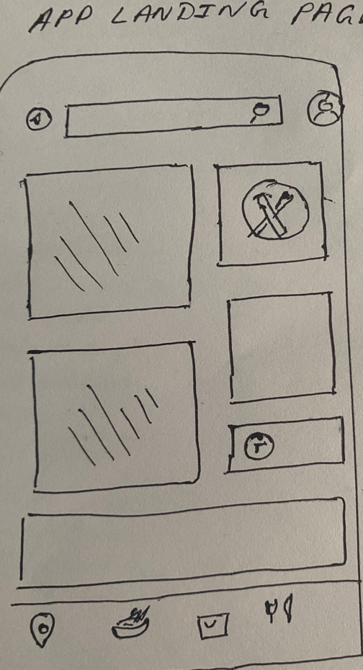
Start Page
This is the page which is shown as the Start page when the users open the app after downloading the app, it has a search box, by default it takes the location, on click of the profile icon the user will get navigated to the login/ sign up page.
Profile
Location
Search box
Near Me locations
Cart
Eat out
Food and restaurants
Notes:
© Copyright UpGrad Education Pvt. Ltd. All rights reserved

Slide 45
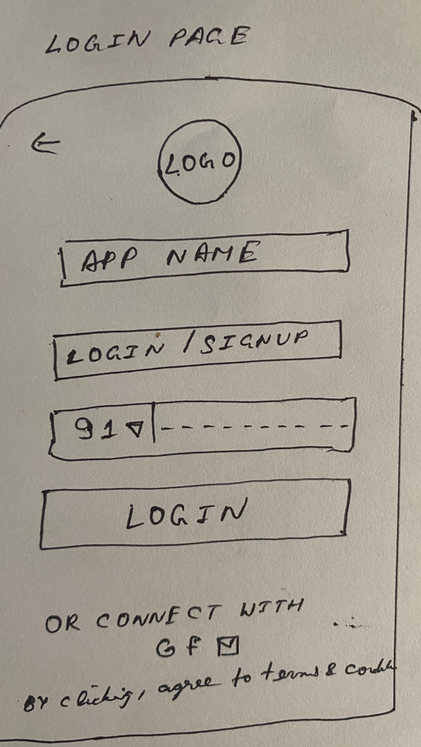
Login Page
This is the login page; it contains an app logo and name. If the user tries to login with the already registered phone number, then the login button will be enabled else the user will be navigated to the next Sign-up page. There are other options to login/sign up with like Google, Facebook, or Email, there is also a back button in the top left corner.

Slide 46
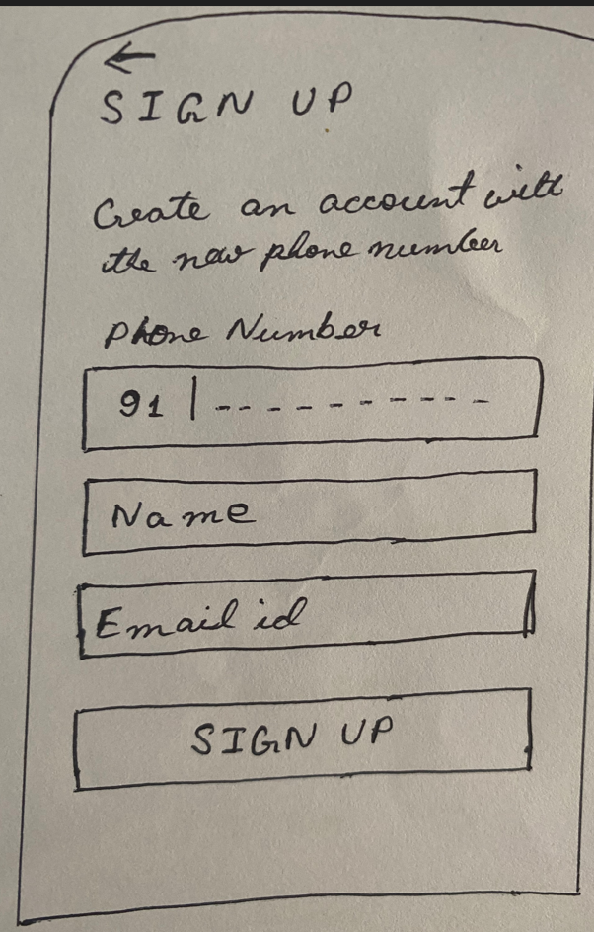
Sign-up
This is a Sign-up page, which asks for the user’s Phone number, Name, Email id, a SIGN-UP button and a Back button at the top left corner.

Slide 47
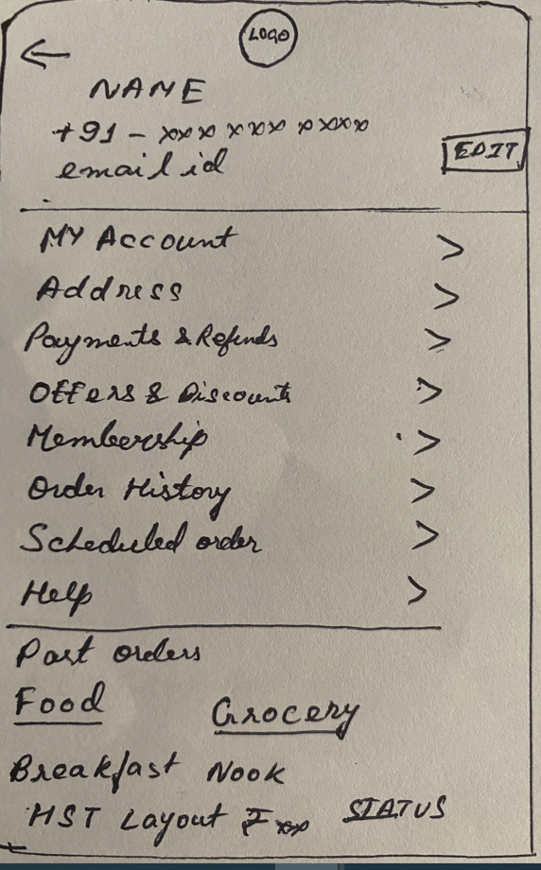
Profile page
Profile page has all the details about the us, like name, phone, email and there is an edit button to edit the same. Also, there is a back button. There are options to navigate to the detail page for account, address, payments, refunds etc. also there are navigation for Scheduling order detail and reminders page, logout and help section.

Slide 48
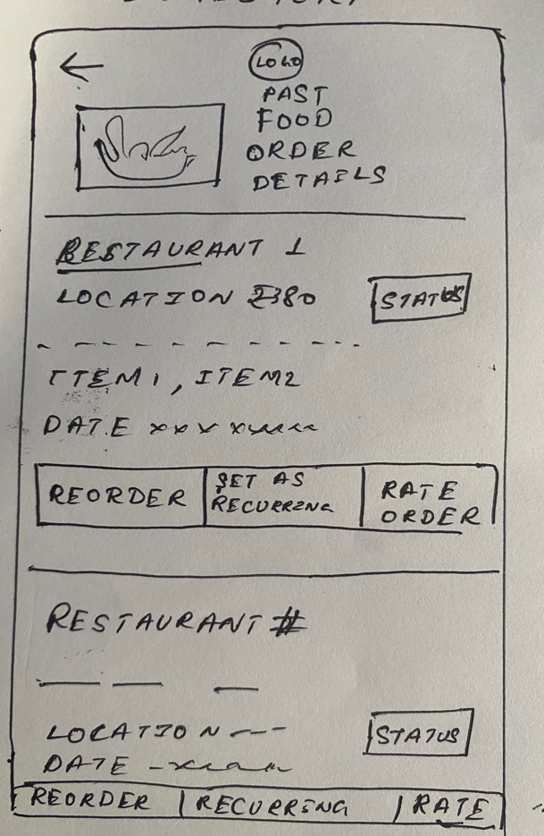
Past Order History
Order history, this will have the list of all past orders, the user will have the option to Reorder, Set that order as Recurring, Rate Order also a Back button to go to the previous screen.

Slide 49
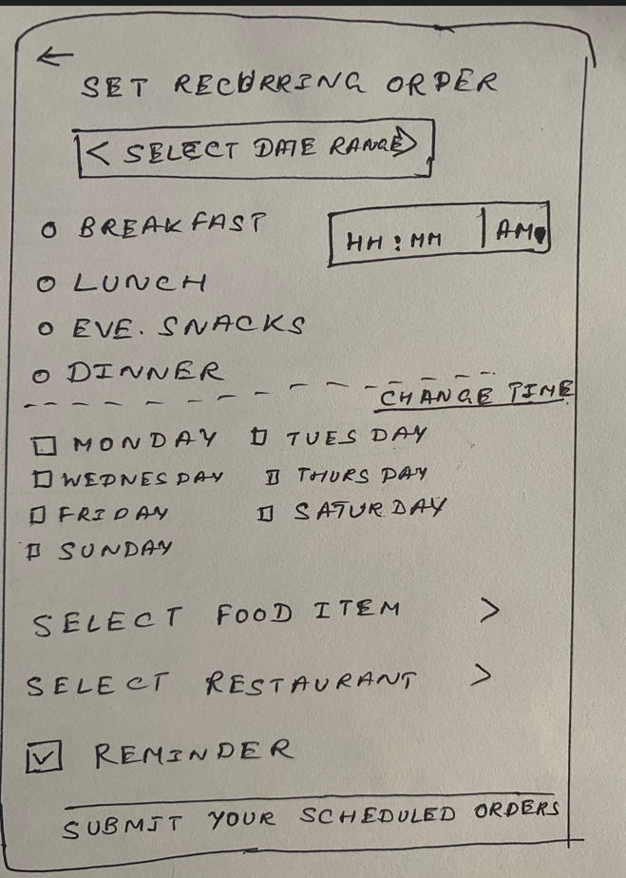
Schedule Orders
This page is to schedule or view pre- scheduled orders, option to select a meal and set a time, select days, type of food and restaurants for the same, also option is there to set reminders and submit the details.
Back button to navigate to the previous screen.

Slide 50
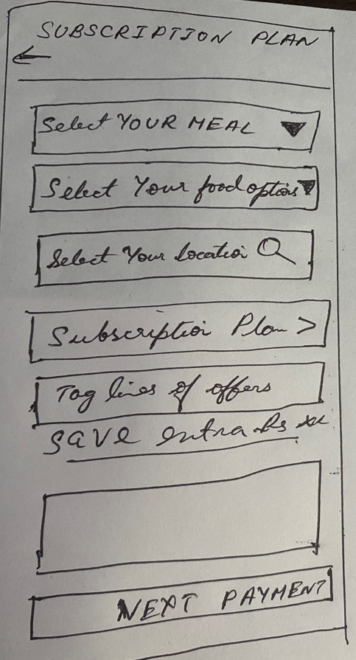
Subscription Plan for Pre-Orders
This page enables user to select a subscription plan for them for their pre ordered meal, subscription plan is available for all meal types and also, allows them chose their favorite menu which will bring down the overall cost of their food.

Slide 51
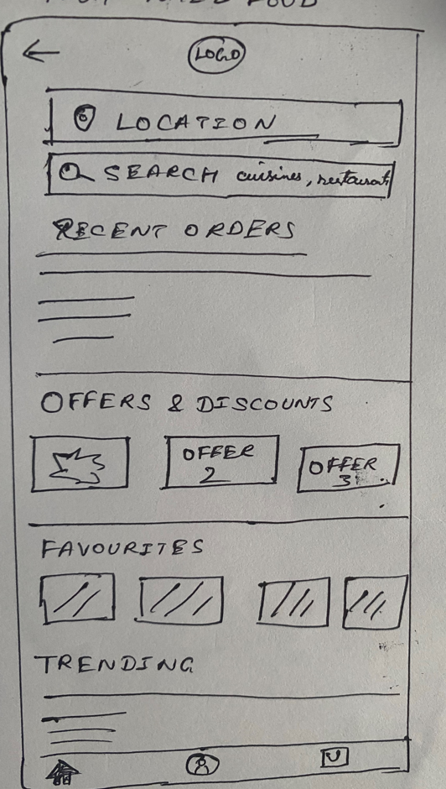
Favorite/recent/offer food items
App logo, with location and search box, below there is a slide view of recent, favorites and on offers food items displayed, also a back button.
Below there is a home, profile and a cart icons to navigate to.

Slide 52
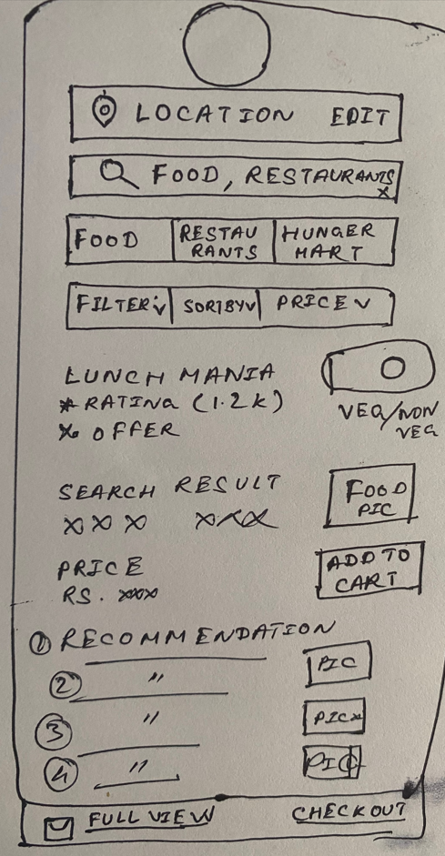
Search Page
This is the search page, if user clicks on the search icon after entering any food item or restaurant then he is given the items matching or related to the text below, there is option to select veg/non-veg, recommendation are also displayed below.
Veg/Non-Veg
Add to cart
CheckOut
Cart full view link

Slide 53
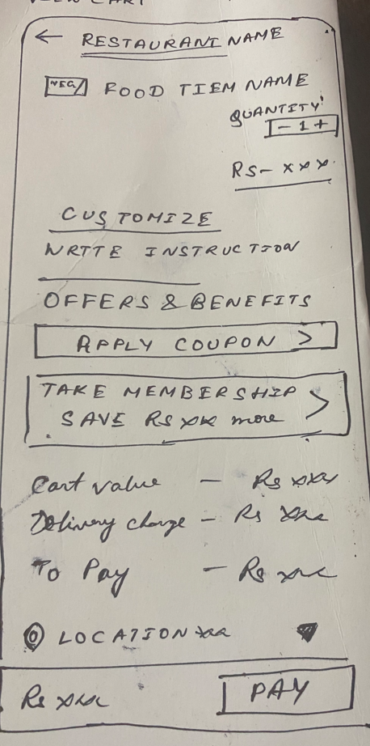
View Cart Page
It has the restaurant selected, food items added in the cart, veg/non-veg, quantity, cart value, and other options like to Take membership etc. location, cart value and delivery charge and Pay button. A Back button to navigate back.

Slide 54
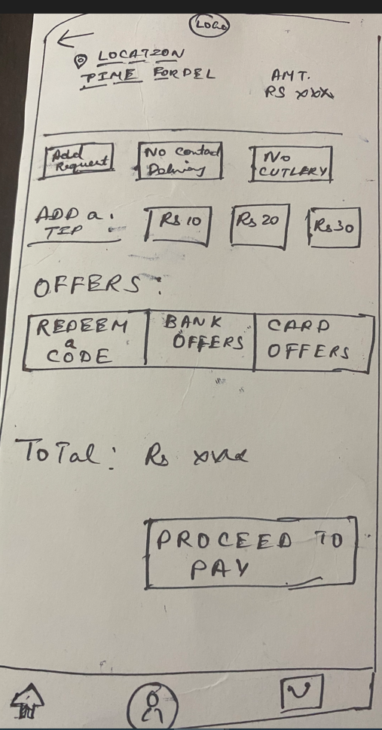
Final Cart view with offers
Location of the food delivery, time for delivery, amount. The are options to add request for the order, No Contact Delivery etc. Also, option to add a tip, offers are listed. Total amount and Proceed to Pay button, below is the home, profile and cart icons.

Slide 55
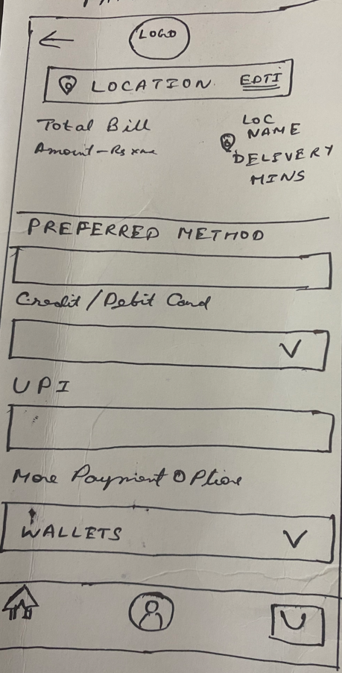
Payment Page
Delivery location- with edit option, bill amount and time for delivery. Below are listed the payment options like the preferred mode of payment used by the user frequently also other options like Credit/Debit and wallet options are listed. There are options to go to home, profile and cart page back. Also, a back button at top left.

Slide 56
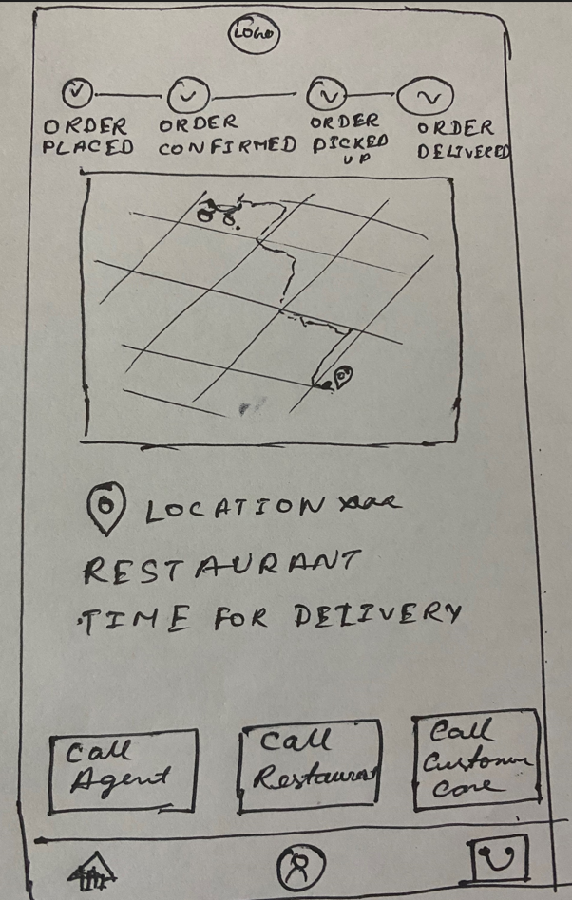
Delivery Tracker
This page is to track the delivery of the items, it shows the progress bar of the status of the order, in a map it shows the route that the delivery a, agent is taking up. Also, there is option to Call Agent, Restaurant people and customer care. Below home, profile and cart icons

Slide 57
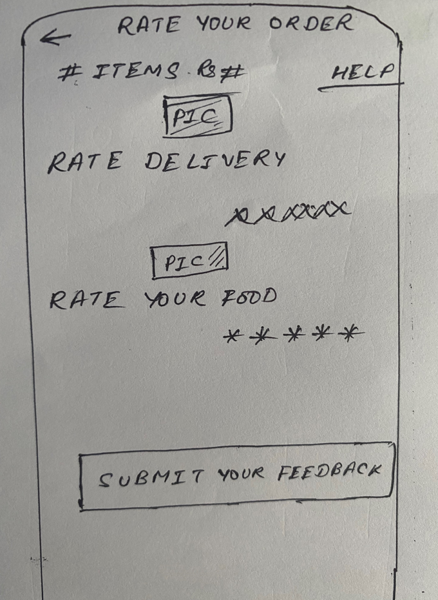
Ratings Page
This page come after order is placed and delivered, for the users to provide their feedback for the delivery and the food. Also, Help option is there at the top right to seek any help about the order.

Slide 58
Part 7: Wireframing and Prototyping
Notes:
© Copyright UpGrad Education Pvt. Ltd. All rights reserved

Slide 59
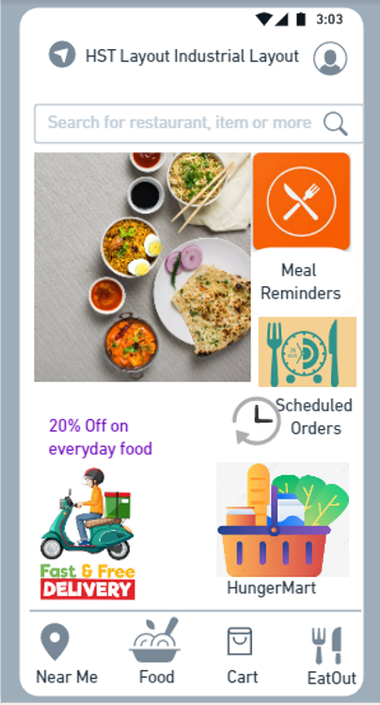
Start Page
Start page for the users after the app is downloaded and opened before login.
Notes:
© Copyright UpGrad Education Pvt. Ltd. All rights reserved

Slide 60
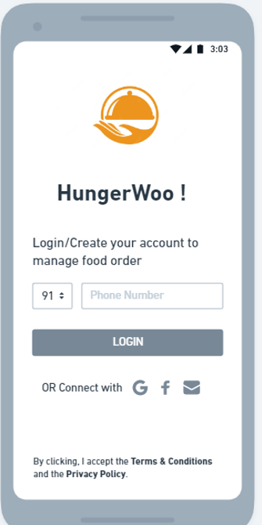
Login Page
Login Page, allows user to login with their registered phone, if the phone is not registered users will be directed to the next Sign-Up page, also option is there to login with Google, facebook etc.
Notes:
© Copyright UpGrad Education Pvt. Ltd. All rights reserved

Slide 61
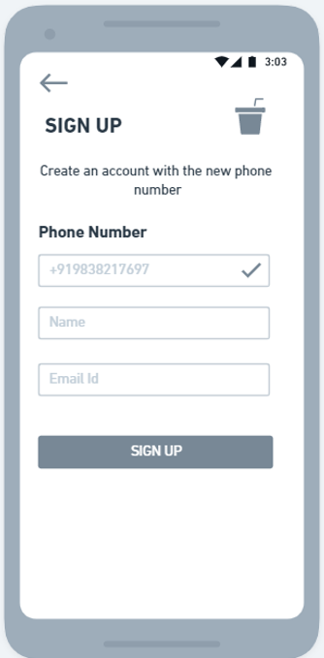
Sign Up
Sign-up page, for new numbers, it will ask for the Name, email id and register the user.
Notes:
© Copyright UpGrad Education Pvt. Ltd. All rights reserved

Slide 62
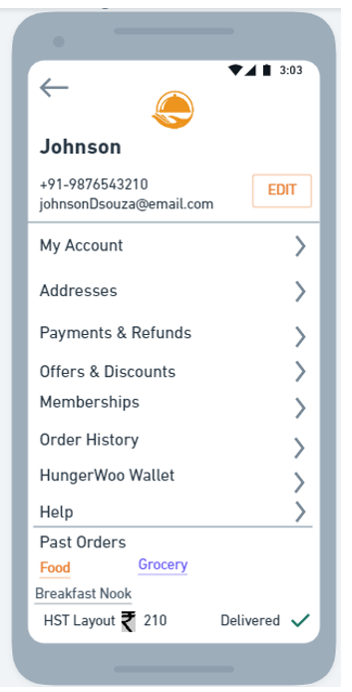
Profile Page
It is the user profile page, which contains details about the user also, navigation to the different sections like account, address, subscription etc.
Notes:
© Copyright UpGrad Education Pvt. Ltd. All rights reserved

Slide 63
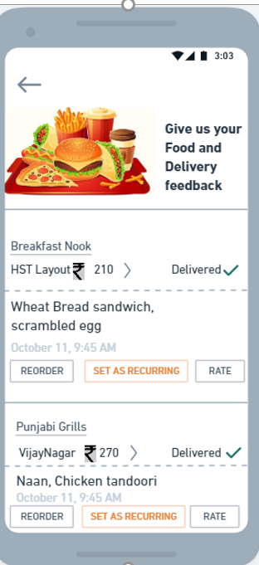
Order History
This page shows the order history of the user with options for using this order for reordering, set this order as recurring and rate the order.
Notes:
© Copyright UpGrad Education Pvt. Ltd. All rights reserved

Slide 64
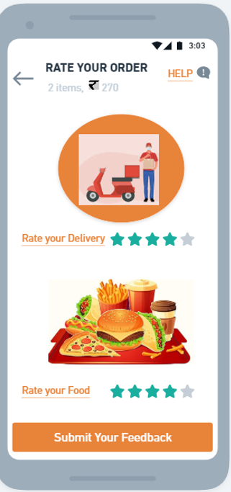
Rate the Order
Rate the delivery and the food item as well, also there is a help link in top right.
Notes:
© Copyright UpGrad Education Pvt. Ltd. All rights reserved

Slide 65
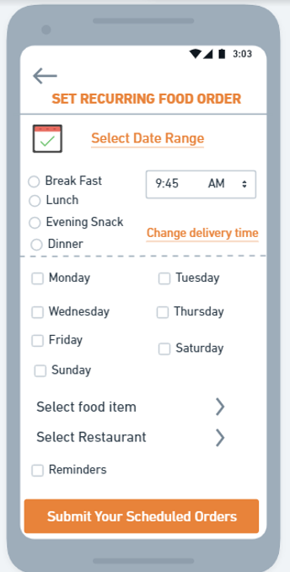
Schedule meals
Scheduling the pre order meals as per user’s choice of food items, dates, days, time also there is a reminder option for the user.
Notes:
© Copyright UpGrad Education Pvt. Ltd. All rights reserved

Slide 66
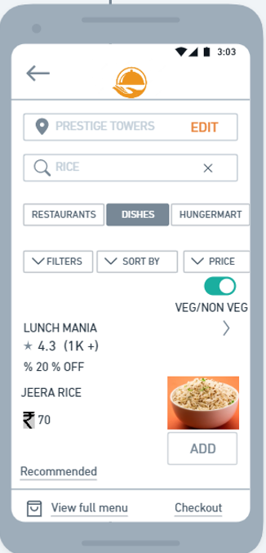
Search Page
This is a search page, upon entering anything in the search box, user is shown the matching or related items or restaurants, users can select and add to cart the same.
Notes:
© Copyright UpGrad Education Pvt. Ltd. All rights reserved

Slide 67
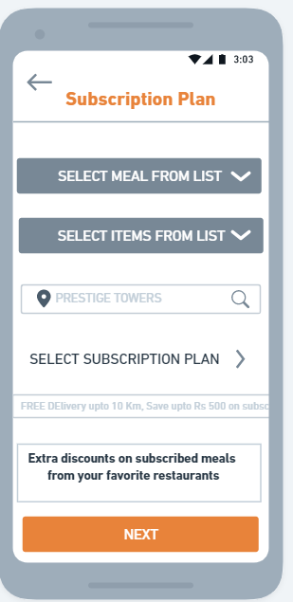
Subscription Plan for Pre Order meals
This page has the features like the user can select from their subscription plan for their meal type and choice of food.

Slide 68
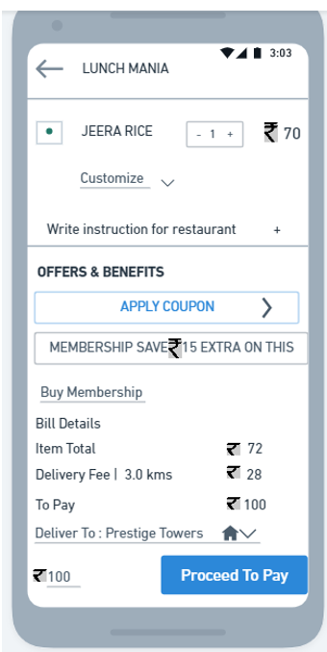
View Cart
Users can view their cart from this page, they can also have a view of the offers and the total amount of their cart values.
Notes:
© Copyright UpGrad Education Pvt. Ltd. All rights reserved

Slide 69
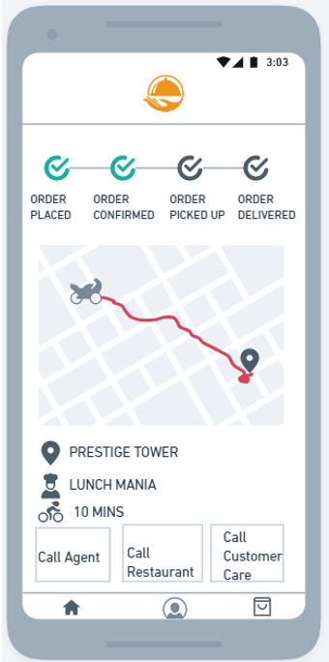
Track your delivery
This page has the food order delivery status and progress details, also there are options to call the delivery agent, restaurant and the customer care.
Notes:
© Copyright UpGrad Education Pvt. Ltd. All rights reserved

Slide 70
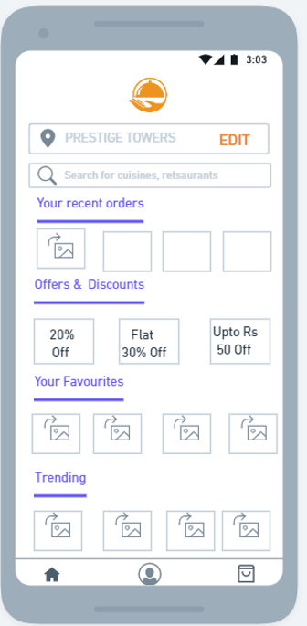
Favourites and offers
This page shows the users their frequently ordered meal, the best offers and the trending meals, at the top there is option to select the location and search for food and restaurant
Notes:
© Copyright UpGrad Education Pvt. Ltd. All rights reserved

Slide 71
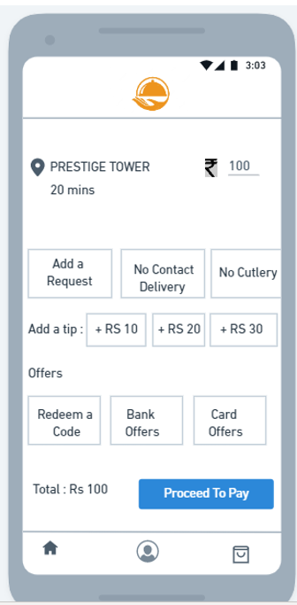
Final Cart page
This is the before payment page, to check and apply the offers, add a tip and request for any instruction.

Slide 72
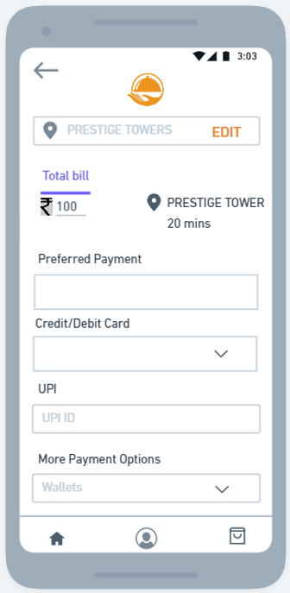
Payment Page
Payment page, in this page the order summary with the delivery location and time of delivery id shown, also using the preferred mode of payment and other payment options are listed as well.

Slide 73
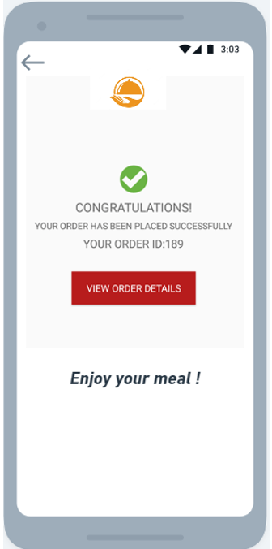
Order Success
This page shows a success message after placing the order.

Slide 74
Navigational Flow
Start/Home Page
Search food, restaurant/ Add to cart
Make Payment
Sign-up
Sign-in
View cart
Order history
Order Success
Schedule Order & reminders
Profile page
Verify the cart amount and items
Chose Subscription Plan
View and apply the offers
Track Delivery

Slide 75
Tools used
Wireframing | <Whimsical>
Prototyping | <Whimsical>
Notes:
© Copyright UpGrad Education Pvt. Ltd. All rights reserved

Slide 76
Prototyping
Prototyping | https://whimsical.com/getting-started-boards-Rp2AMQtGw73pH7MFcSDSmK
Notes:
© Copyright UpGrad Education Pvt. Ltd. All rights reserved

Slide 77
Disclaimer: All content and material on the UpGrad website is copyrighted material, either belonging to UpGrad or its bonafide contributors and is purely for the dissemination of education. You are permitted to access print and download extracts from this site purely for your own education only and on the following basis:
You can download this document from the website for self-use only.
Any copies of this document, in part or full, saved to disc or to any other storage medium may only be used for subsequent, self-viewing purposes or to print an individual extract or copy for non-commercial personal use only.
Any further dissemination, distribution, reproduction, copying of the content of the document herein or the uploading thereof on other websites or use of content for any other commercial/unauthorized purposes in any way which could infringe the intellectual property rights of UpGrad or its contributors, is strictly prohibited.
No graphics, images or photographs from any accompanying text in this document will be used separately for unauthorised purposes.
No material in this document will be modified, adapted or altered in any way.
No part of this document or UpGrad content may be reproduced or stored in any other web site or included in any public or private electronic retrieval system or service without UpGrad’s prior written permission.
Any rights not expressly granted in these terms are reserved.

